Slide 1
Warm-Up: Take a ¼ sheet.
Read the following sentences. Choose one of the activities below it to complete.
-Our cruise ship was a tall vessel.
-Mark likes to explore while diving and will venture into dark places.
Copy any of the underlined words you don’t know how to say and use the rules for chunking words to determine how to say them.
Choose at least one of the underlined words and write a definition for it using context clues.
Write an antonym for any of the underlined words.
When finished, complete Interactive Reading and/or iPractices/ Study Plans.

Slide 2
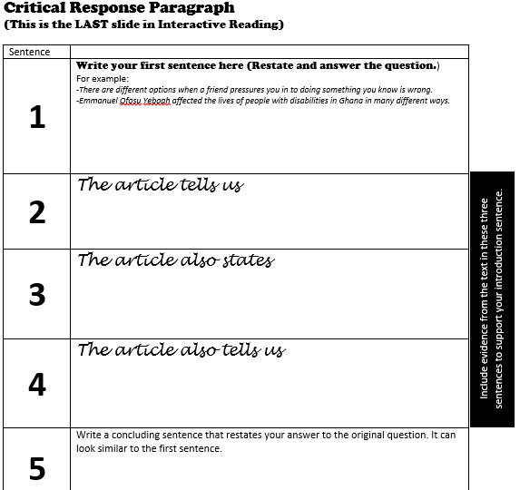

Slide 3
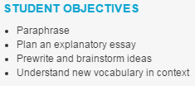

Slide 4
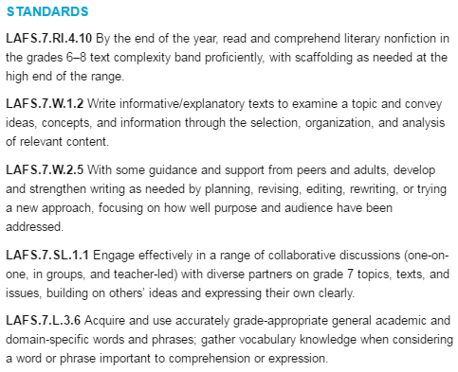

Slide 5
 | Agenda
Time (min.’s) | Unit: Taking Chances Essential Question: What makes some people push the limits?
10 | Interactive Reading
5 | Vocabulary (vessel, venture)
15 | Read Aloud At the Edge (Chapter 4, section 1: “Lynmouth’s Challenge”) Questioning, Predicting, Summarizing
10 | Classroom Conversation
10 | Whole Group (Central Idea)
35 | Work Time (3.14 Plan an Argumentative Paragraph and 3.14 Write an Argumentative Paragraph)
5 | Wrap-Up

Slide 6
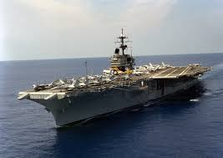
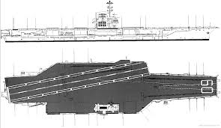
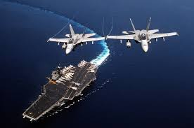
3.16
Vessel: large boat or ship
Although he spent two and a half years on the large vessel, Mr. Kern was never allowed to ____________________.
Venture: to bravely go somewhere dangerous, risky, or unknown
Pilots from the USS Saratoga venture off into the __________________________.

Slide 7
3.1
Evacuate: Leave a place in an organized manner.
In World War II, the bombing was so bad in London that the children _____________ to evacuate.
Valiant: Full of courage. Brave.
The British soldiers were valiant when they _____________.
3.2
Piercing: Loud and shrill.
___________ gave a piercing _____ when ________________.
Mutiny: Refusal to obey orders given by someone in charge, especially sailors or soldiers against their officers.
The ship’s captain was injured when the ________ held a mutiny.
3.3
Ease: Without difficulty.
The Hulk could _____________ with ease.
Altering: Changing or making something different.
__________ could not become ________ without altering ____________.
3.4
Brilliant: Very bright or intense.
After the Alien kidnapped me, I stood looking at the brilliant colors on _____________.
Clinging: Holding on tightly.
I could not help clinging on to __________ as the Alien threw me from ____________.

Slide 8
3.6
Stabilize: to make or hold something firm or steady
When he flies, Superman uses ______________ to stabilize himself.
Amble: walk at a slow, relaxed pace
Fred loved to amble down the street with ______________.
3.7
Pondered: Thought very seriously and carefully about something.
Humpty Dumpty sat on the wall pondering if _____________________.
Rumors: Information passed from one person to another that may or may not be true; gossip.
No one wanted to believe the rumors that the elephant really was _____________.
3.8
Preserve: To keep something from change or unwanted harm. Protect.
To preserve the environment, people often ____________.
Escort: To walk or drive with someone or something for protection.
It is the job of the secret service to escort ___________.
3.9
Descend: To move from a higher place to a lower place.
The hot air balloon began to descend rapidly when _________________.
Fissure: a split or crack in a rock or the Earth.
The Thing got very angry and __________, causing fissures in the mountain.

Slide 9
3.11
Oppression: cruel or unjust treatment of people
It was there, too, when Irena Sendlerowa, a twenty-nine-year-old social worker, fought in secret to save the lives of the Jews of Warsaw, targets of Nazi oppression.
Infiltrated: to move into an area secretly in order to cause someone harm
Disguised as a nurse, she infiltrated the heavily guarded ghettos.
3.12
Exterminate: To kill or destroy completely.
Hitler ____________ to exterminate all of the Jewish people in his concentration camps.
Operational: Ready to be used.
The ________________were operational for nearly 12 and a half years during the Holocaust.
3.13
Similar: Alike in some way.
Hitler ____________ to exterminate all of the Jewish people in his concentration camps.
Frail: Physically weak and thin.
The ________________were operational for nearly 12 and a half years during the Holocaust.
3.14
Condemned: given a strong punishment; sentenced
With a swing of his gavel, the judge condemned the clown to 20 years for _________________________.
Forge: to make, shape, or form with careful effort; to develop something new
After his 20 years in prison, the clown tried to forge a new life as a _______________.

Slide 10
3.15
Divert: to change someone’s attention from one thing to another
The Power Puff Girls tried to divert Godzilla’s attention by _____________________.
Simmering: starting to get angry or upset
Though the Power Puff Girls looked okay on the outside, they were simmering on the inside because _________________.
3.16
Vessel: large boat or ship
Although he spent two and a half years on the large vessel, Mr. Kern was never allowed to ____________________.
Venture: to bravely go somewhere dangerous, risky, or unknown
Pilots from the USS Saratoga venture off into the __________________________.

Slide 11
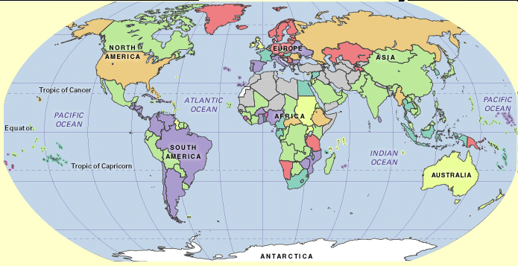
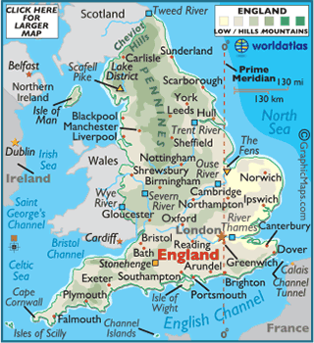
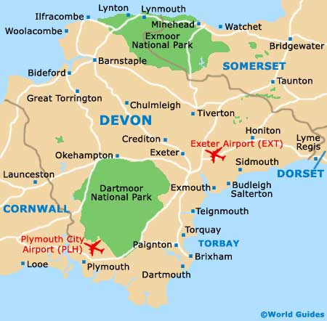
Lynmouth, England

Slide 12
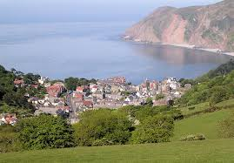
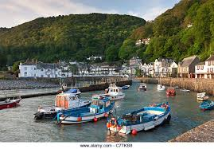
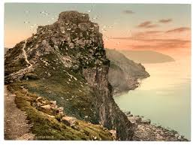

Slide 13
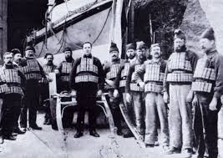
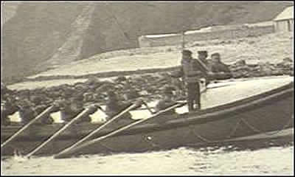
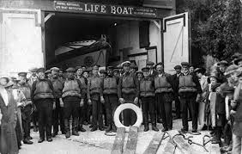
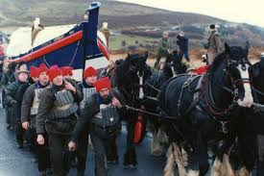

Slide 14
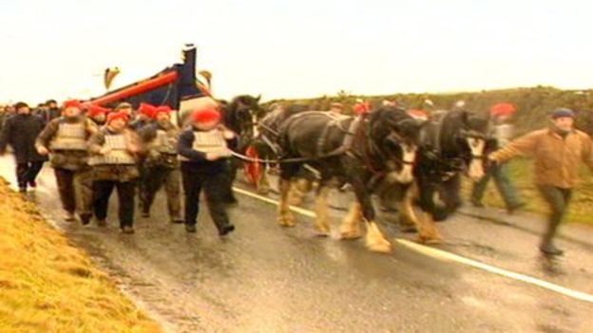

Slide 15
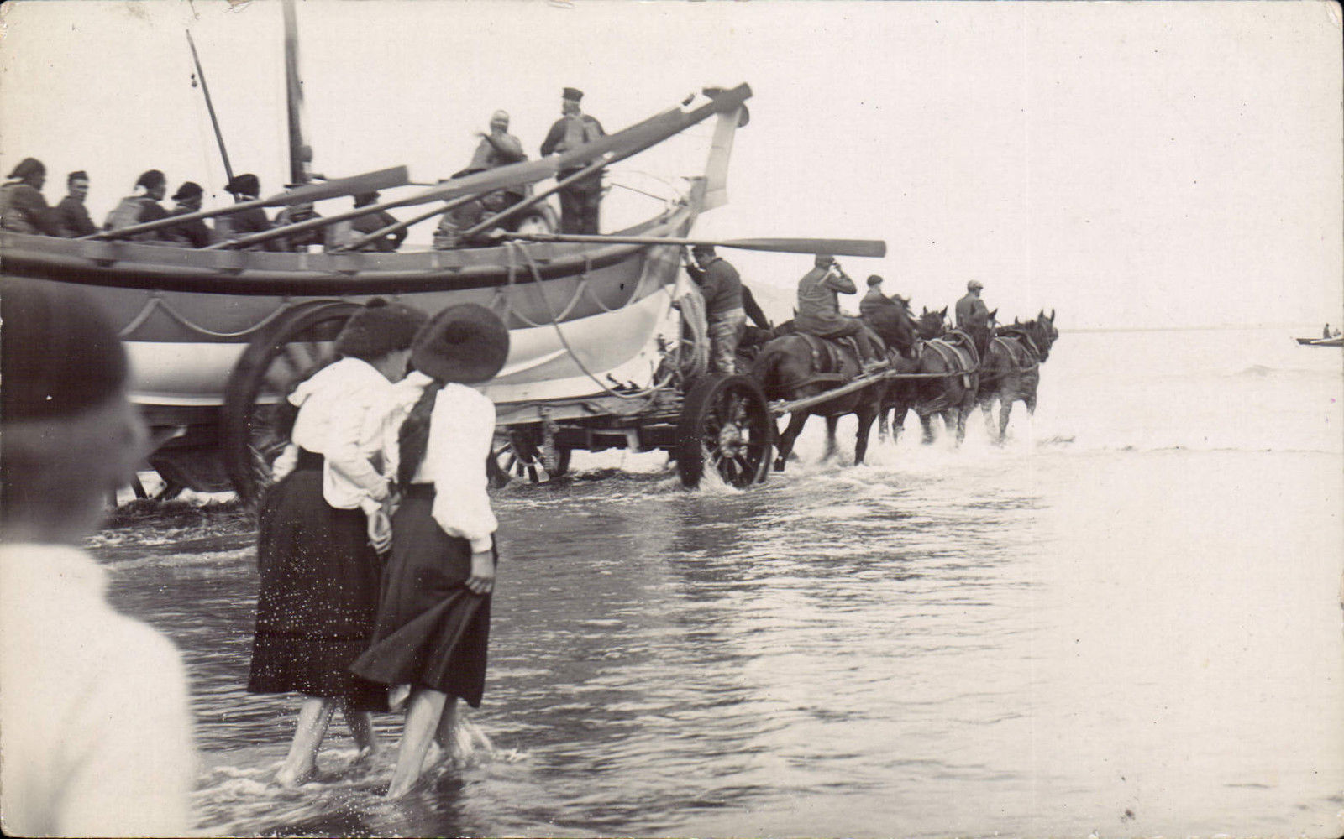
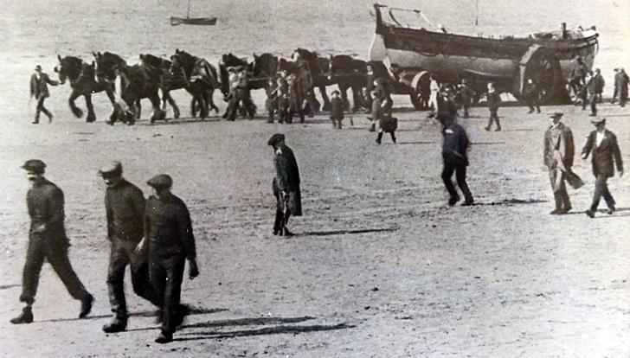

Slide 16
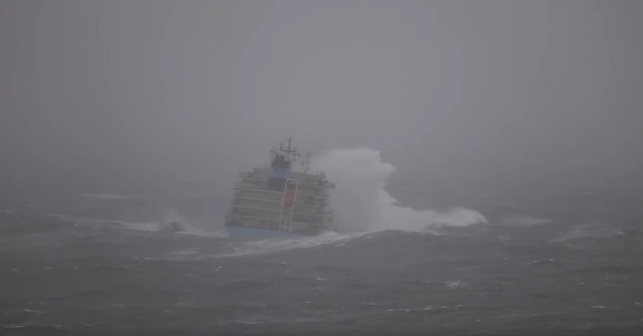

Slide 17
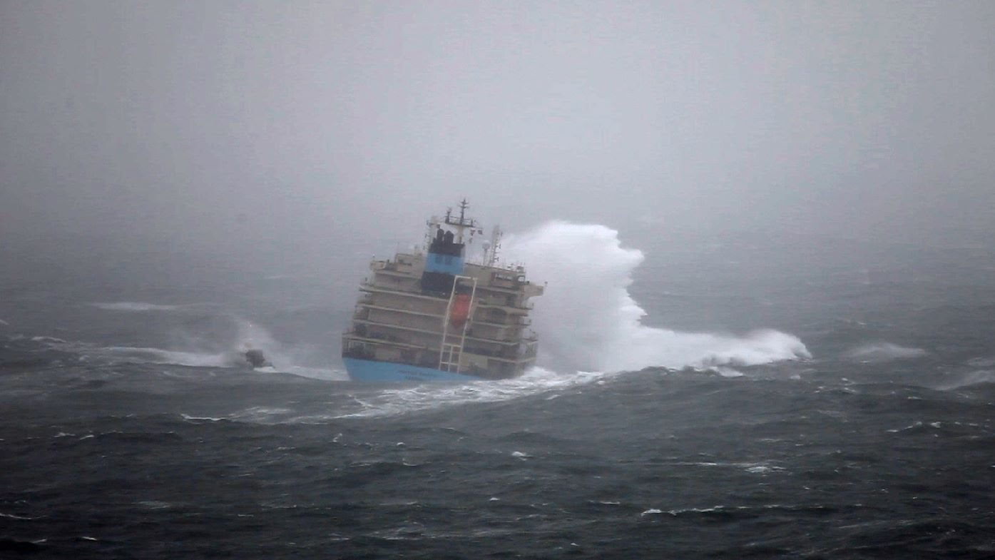

Slide 18
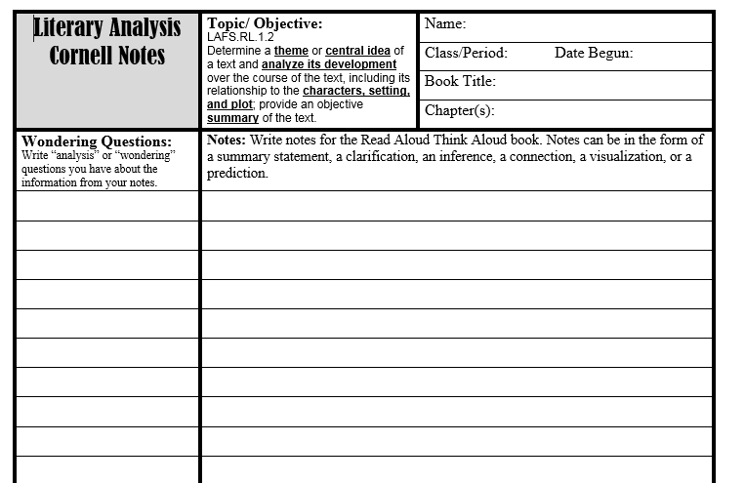
At the Edge
4
Summarizing
Questioning
Lynmouth’s Challenge

Slide 19
Part A
What is the central idea of the story “Lynmouth’s Challenge?”
The story of the Forrest Hall has been passed down from one generation to the next.
The men of Lynmouth worked hard and risked their lives to save sailors of the Forrest Hall.
There were enough men on the Forrest Hall to save the ship, but they waited on the men from Lynmouth.
The men of the Forrest Hall were starving and near death when they were saved by the men of Barry.

Slide 20
Part B The men of Lynmouth worked hard and risked their lives to save sailors of the Forrest Hall.
Which two of the following details support your answer to Part A?
A. After a night of hauling the lifeboat over land, the men rowed for an hour more in the stormy sea to reach the Forrest Hall.
B. The next day the seas were calm.
C. There was one town nearby that had a sheltered cove.
D. On January 12, 1899, wind battered the tiny seaside village of Lynmouth, England, shattering windows and blasting doors.
E. With everyone’s help the carriage was lifted, the wheel reattached, and the pushing and pulling resumed. Hours later they arrived at the top of the hill, 1,000 feet above Lynmouth.

Slide 21
Work Time:
Any incomplete iPractices.
Interactive Reading
Unit 3 Grammar Study Plan
Vocabulary Study Plan
Spelling Study Plan
Independent Reading

Slide 22
Wrap Up
What is the greatest venture you have ever been on?

